Slide 1

COMP7500/7506 Advanced Operating Systems
Disk Access Time, SSD, NAS, and SAN
Dr. Xiao Qin
Auburn University http://www.eng.auburn.edu/~xqin
xqin@auburn.edu

Slide 2
Learning Objectives: Storage Devices
1
2
Solid-State Disks
Disk Access Time
3
NAS and SAN

Slide 3
Notes:
Magnetic disks provide bulk of secondary storage of modern computers
Drives rotate at 60 to 250 times per second
Transfer rate is rate at which data flow between drive and computer
Positioning time (random-access time) is time to move disk arm to desired cylinder (seek time) and time for desired sector to rotate under the disk head (rotational latency)
Head crash results from disk head making contact with the disk surface -- That’s bad
Disks can be removable
Drive attached to computer via I/O bus
Busses vary, including EIDE, ATA, SATA, USB, Fibre Channel, SCSI, SAS, Firewire
Host controller in computer uses bus to talk to disk controller built into drive or storage array

Slide 4
How to compute average rotational delays? Example: A hard drive’s RPM is 120.
Step 1: Round/Sec
Step 3: Half Round
Step 2: Sec /Round
From 2 Round/Sec
To 1 Sec/2 Round
= 0.5 Sec/Round
Half Round:
0.5/2 Second
= 0.25 Second
= 250 ms
120 RPM =
120 Round/60 Sec
= 2 Round/Sec

Slide 5
Exercise 1 (Menti): What is the average rotational delay if a hard drive’s RPM is 7200?
6.90 microsecond
0.14 millisecond
4.17 millisecond
8.33 millisecond

Slide 6
Hard Disk Performance
Average access time
= average seek time + average rotational delays
Fast Disk: 3ms + 2ms = 5ms
Slow Disk: 9ms + 5.56ms = 14.56ms
Average I/O time = average access time + transfer time
+ controller overhead

Slide 7
How to compute transfer time? Example: Data Size = 4 KB Transfer Rate = 8 Mb/Sec
Step 1: Formula
Step 3: Put It All
Step 2: Convert Unit
Transfer Rate =
(8Mb/sec)*(1MB/8Mb)
= 1 MB/sec
= 1K * KB/sec
Data Size/Trans_Rate
= 4 KB/(1K*KB/sec)
= 4 Sec/ 1024
= 0.0039 sec
= 3.9 ms
Transfer Time =
Data Size /
Transfer Rate

Slide 8
Exercise 2 (Menti): Suppose a 7200-RPM disk transfers a 4KB block with a 5ms average seek time, 1Gb/sec transfer rate with a 0.1ms controller overhead?
9.27 ms
9.302 ms
5.302 ms
9.17 ms

Slide 9
Hard Drive vs. Solid-State Disks
Notes:
Nonvolatile memory used like a hard drive
Many technology variations
Can be more reliable than HDDs
More expensive per MB
Maybe have shorter life span
Less capacity
But much faster
Busses can be too slow -> connect directly to PCI for example
No moving parts, so no seek time or rotational latency

Slide 10
Exercise 3 (Group Discussion): HDD vs. SSD Please complete the following comparison table.
 | Hard Disks | Solid-State Disks
Reliability
Cost
Life Span
Capacity
Performance
Notes:
Nonvolatile memory used like a hard drive
Many technology variations
Can be more reliable than HDDs
More expensive per MB
Maybe have shorter life span
Less capacity
But much faster
Busses can be too slow -> connect directly to PCI for example
No moving parts, so no seek time or rotational latency

Slide 11
Disk Attachment: How to access disk storage?
1
2
NAS: Network-Attached Storage
Host-Attached Storage
3
SAN: Storage-Area Netowrk

Slide 12
Host-Attached Storage

Slide 13
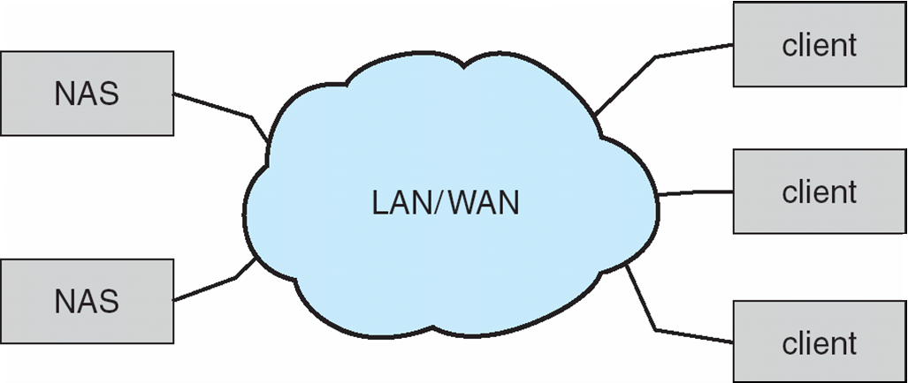
NAS: Network-Attached Storage
Storage made available over a network
NFS and CIFS are common protocols
Implemented via remote procedure calls (RPCs) between host and storage over typically TCP or UDP on IP network
iSCSI protocol uses IP network to carry the SCSI protocol
Notes:
SCSI protocol on top of TCP/IP protocols.
Network-attached storage (NAS) is storage made available over a network rather than over a local connection (such as a bus)
Remotely attaching to file systems
NFS and CIFS are common protocols
Implemented via remote procedure calls (RPCs) between host and storage over typically TCP or UDP on IP network
iSCSI protocol uses IP network to carry the SCSI protocol
Remotely attaching to devices (blocks)
https://en.wikipedia.org/wiki/SCSI
Small Computer System Interface (SCSI, /ˈskʌzi/ SKUZ-ee)[1] is a set of standards for physically connecting and transferring data between computers and peripheral devices.

Slide 14
NAS: Network-Attached Storage
Notes:
Network-attached storage (NAS) is storage made available over a network rather than over a local connection (such as a bus)
Remotely attaching to file systems
NFS and CIFS are common protocols
Implemented via remote procedure calls (RPCs) between host and storage over typically TCP or UDP on IP network
iSCSI protocol uses IP network to carry the SCSI protocol
Remotely attaching to devices (blocks)
https://en.wikipedia.org/wiki/SCSI
Small Computer System Interface (SCSI, /ˈskʌzi/ SKUZ-ee)[1] is a set of standards for physically connecting and transferring data between computers and peripheral devices.

Slide 15
SAN: Storage Area Network
Common in large storage environments
Multiple hosts attached to multiple storage arrays
Notes:
Common in large storage environments
Multiple hosts attached to multiple storage arrays - flexible
SAN is one or more storage arrays
Connected to one or more Fibre Channel switches
Hosts also attach to the switches
Storage made available via LUN Masking from specific arrays to specific servers
Easy to add or remove storage, add new host and allocate it storage
Over low-latency Fibre Channel fabric
Why have separate storage networks and communications networks?
Consider iSCSI, FCOE

Slide 16
SAN: Storage Area Network
SAN uses storage protocols rather than network protocols.
Notes:
Common in large storage environments
Multiple hosts attached to multiple storage arrays - flexible
SAN is one or more storage arrays
Connected to one or more Fibre Channel switches
Hosts also attach to the switches
Storage made available via LUN Masking from specific arrays to specific servers
Easy to add or remove storage, add new host and allocate it storage
Over low-latency Fibre Channel fabric
Why have separate storage networks and communications networks?
Consider iSCSI, FCOE

Slide 17
Exercise 4: What are the differences between NAS and SAN?
Notes:
SAN is one or more storage arrays
Connected to one or more Fibre Channel switches
Hosts also attach to the switches
Storage made available via LUN Masking from specific arrays to specific servers
Easy to add or remove storage, add new host and allocate it storage
Over low-latency Fibre Channel fabric
Why have separate storage networks and communications networks?
Consider iSCSI, FCOE

Slide 18
Exercise 5 (Group Discussion): Why storage networks and communications networks are separated in SAN?
Notes:
SAN is one or more storage arrays
Connected to one or more Fibre Channel switches
Hosts also attach to the switches
Storage made available via LUN Masking from specific arrays to specific servers
Easy to add or remove storage, add new host and allocate it storage
Over low-latency Fibre Channel fabric
Why have separate storage networks and communications networks?
Consider iSCSI, FCOE

Slide 19
Exercise 6: Let’s compare NAS and SAN.
 | NAS | SAN
Performance
Cost
Protocols
Flexibility
Notes:
Nonvolatile memory used like a hard drive
Many technology variations
Can be more reliable than HDDs
More expensive per MB
Maybe have shorter life span
Less capacity
But much faster
Busses can be too slow -> connect directly to PCI for example
No moving parts, so no seek time or rotational latency

Slide 20

Summary
How to compute disk access time?
What is host-attached storage?
What is NAS?
What is SAN?
Reading Assignment:
Chapter 10.1.2-10.3.3 pp. 469-472
Notes:
Cont. ch3.ppt, slide 44 Synchronization

Slide 21
What’s Next?
Disk Scheduling Algorithms
Reading Assignment:
Chapter 10.4 pp. 472-478.
Notes:
Cont. ch3.ppt, slide 44 Synchronization

